Slide 1
miniproject v
Machine translation

Slide 2
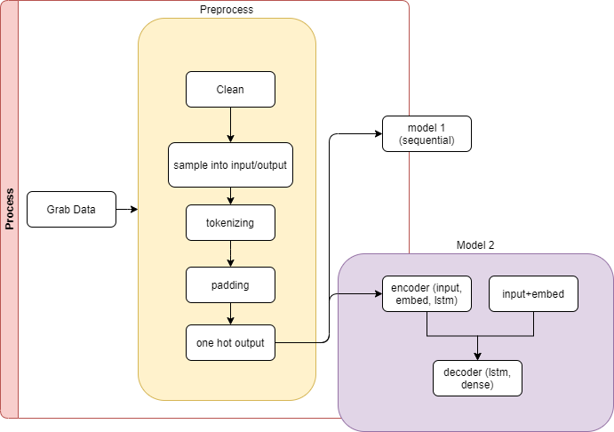

Slide 3
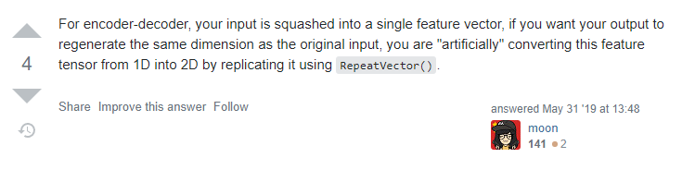
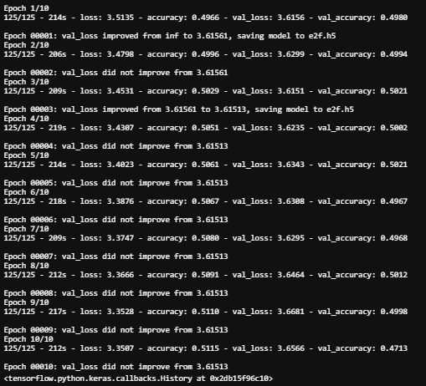
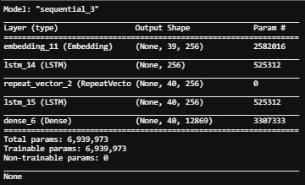
sequential model i
'the resolution makes clear there is a need for a proportional system that gives form to women s representation and that all political parties must take action’
il le la de de de de de de de de de de de de de de de de de de de de de de eos eos eos

Slide 4
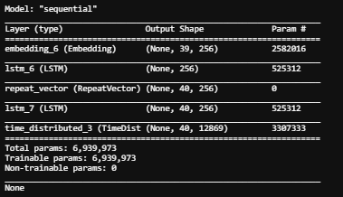
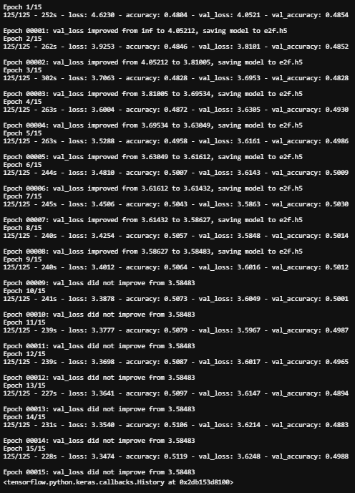
sequential model ii – time distributed
'the resolution makes clear there is a need for a proportional system that gives form to women s representation and that all political parties must take action’
dynamique dynamique dynamique dynamique dynamique dynamique dynamique dynamique dynamique dynamique dynamique pourrez pourrez pourrez pourrez pourrez pourrez pourrez pourrez pourrez pourrez pourrez pourrez pourrez pourrez pourrez pourrez pourrez pourrez pourrez pourrez pourrez pourrez pourrez pourrez pourrez pourrez pourrez pourrez pourrez

Slide 5
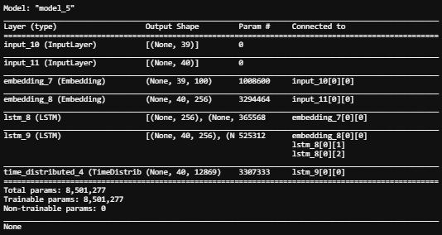
model from walkthrough
Input – Output – Google translate validation
'some rights will apply to anyone present in the eu territory while others will benefit only citizens of the european union'
applaudissements certains s signaler a toute personne presente sur le territoire de l union d autres auront pour seuls reelles les citoyens de l union eos eos eos eos eos eos eos eos eos eos
applause some signal to anyone present on the territory of the union others will have for real the citizens of the union eos eos eos eos eos eos eos eos eos eos
'the resolution makes clear there is a need for a proportional system that gives form to women s representation and that all political parties must take action’
permettezmoi la resolution dit clairement que le systeme britannique qui permet la chine des femmes est necessaire et que les partis politiques doivent agir en ce sens eos eos eos eos eos eos eos
allow me the resolution makes it clear that the british system which allows women china is necessary and that political parties must act in this direction eos eos eos eos eos eos eos
Notes:
https://stackabuse.com/python-for-nlp-neural-machine-translation-with-seq2seq-in-keras/

